Slide 1

G.H. RAISONI INSTITUTE OF ENGINEERING & TECHNOLOGY, NAGPUR
(An Autonomous Institute Affiliated to Rashtrasant Tukadoji Maharaj Nagpur University, Nagpur) NBA & NAAC Accredited with A+
2021-2022
Department of Data Science
< “Customer Segmentation Using Machine Learning” >
Guide
Dr. Swapnili Karmore HOD, Associate Professor Data Science Department
Name of Projectees
Pratik Sonune
Shreya Kuthe
Abhijit Akhande
Parag Shahare
Priyal Deshkar
Pranay Ingole

Slide 2

Contents
Abstract
Introduction
Literature Survey
Methodology
Implementation
Results
Conclusion
References

Slide 3
Introduction
Over the years, the increasing competition between businesses and the availability of large-scale historical data has resulted in the extensive use of data mining techniques to discover important and strategic information that is hidden in the information of organizations. Data mining is the process of extracting logical information from a dataset and presenting it in a human-accessible way for decision support. Customer division is the division of the customer base of the business into groups called customer segments such that each customer segment consists of customers who share similar market characteristics The importance of customer segmentation includes, inter alia, the ability of a business to customize market plans that will be appropriate for each segment of its customers; support for business decisions based on a risky environment such as debt relations with their customers; Identification of products related to individual components and how to manage demand and supply power; reveals the interdependence and interaction between consumers, between products, or between customers and products that the business may not be aware of; the ability to predict customer decline, and which customers are most likely to have problems and raise other market research questions and provide clues to finding solutions.

Slide 4
Literature Survey
Customer Classification
Over the years, the commercial world has become more competitive, as organizations such as these have to meet the needs and wants of their customers, attract new customers, and thus improve their businesses. The task of identifying and meeting the needs and requirements of each customer in the business is a very difficult task. This is because customers may vary according to their needs, wants, demographics, shapes, taste and taste, features and so on. As it is, it is a bad practice to treat all customers equally in business. This challenge has led to the adoption of the concept of customer segmentation or market segmentation, where consumers are divided into subgroups or segments where members of each subcategory exhibit similar market behaviors or features. Accordingly, customer segmentation is the process of dividing the market into indigenous groups.
B. BIG Data
Recently, Big Data research has gained momentum. defines big data as - a term that describes a large number of formal and informal data, which cannot be analyzed using traditional methods and algorithms. Companies include billions of data about their customers, suppliers, and operations, and millions of internally connected sensors are sent to the real world on devices such as mobile phones and cars, sensing, creating, and communicating data. the ability to improve forecasting, save money, increase efficiency and improve decision- making in various fields such as traffic control, weather forecasting, disaster prevention, finance, fraud control, business transactions, national security, education, and healthcare.

Slide 5
Literature Survey
C. Data Collection
Data collection is the process of collecting and measuring information against targeted variations in an established system, enabling one to answer relevant questions and evaluate results. Data collection is part of research in all fields of study including physical and social sciences, humanities and business. The purpose of all data collection is to obtain quality evidence that allows analysis to lead to the creation of convincing and misleading answers to the questions submitted. We collected data from the UCI Machine Learning Repository.
D. Clustering Data
Clustering is the process of grouping the information in the dataset based on some similarities. There are a number of algorithms which can be chosen to be applied on a dataset based on the situation provided. However, no universal clustering algorithm exists that's why it becomes important to opt for appropriate clustering techniques. In this paper, we have implemented three clustering algorithms using python sklearn library.
E. K-Mean
K- means that an algorithm is one of the most popular classification algorithm. This clustering algorithm depends on the centroid where each data point is placed in one of the overlapping K clusters pre-programmed into the algorithm, The clusters are created that correspond to the hidden pattern in the data that provides the information needed to help decide the execution process. There are many ways to make k-means assembling; we will use the elbow method.

Slide 6
Methodology
Collect Data
This is a data preparation phase. The feature usually helps to refine all data items at a standard rate to improve the performance of the clustering algorithm. Each data point changes from grade 2 to +2. Integration techniques that include Min-max, decimal and z-points The standard z-signing strategy are used to make things unequal before applying the k-Means algorithm to a dataset.
B. Customer Classification Methods
There are many ways to perform segmentation, which vary in severity, data requirements, and purpose. The following are some of the most commonly used methods, but this is not an incomplete list. There are papers that discuss artificial neural networks, particle fixation, and complex types of ensemble, but are not included due to limited exposure. In future articles, I may go into some of these alternatives, but for now, these more common methods should be sufficient.
C. Group Analysis
Group analysis is a unifying, or unifying, approach for consumers based on their similarities.There are 2 main types of group analysis categorized into market policy: Hierarchical group analysis, and classification (Miller, 2015). In the meantime, we will discuss how to classify clusters called k-methods.

Slide 7
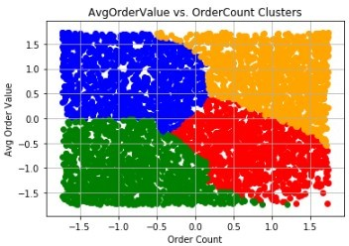




Methodology
D. K-means Encounter
The k-means clustering algorithm is an algorithm that is frequently used to draw insights into the formats and differences within a database. In marketing, it is often used to build customer segments and to understand the behavior of these unique segments. Let's get into building assembly models in the python environment.
E.Centroids Initiation
Selected cents or initials were selected. Figure 1 introduces the start of graduation centers. Four selected centers shown in different shapes were selected using the Forgy method. In Forgy's method of using k (in this case k = 4) data points are randomly selected as cluster centroids.

Slide 8
Technical Introduction
The code below was created in the Jupyter manual using Python 3.x and a few Python packages for editing, processing, analyzing, and visualizing information.
Most of the code below comes from the GitHub package of the book Hands-On Data Science for Marketing. The book is available on Amazon or OilReilly if you are a subscriber.
The open source data used in the following code comes from Cost Irvine's Machine Learning Repository.

Slide 9
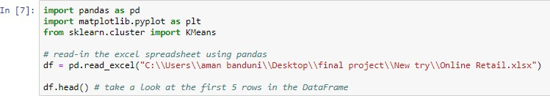
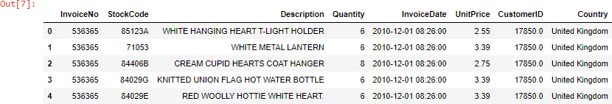
Implementation
Import packages and Data
To start, we import the packages needed to do our analysis and then import the xlsx (excel spreadsheet) data file. If you want to follow along with the same data, you'll need to download it from UCI. For this example, I put the xlsx file in the folder (directory) where I present Jupyter's notebook

Slide 10
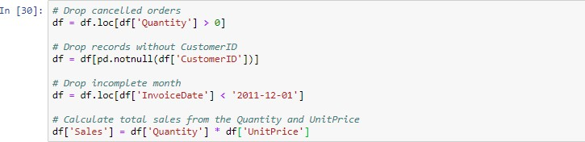
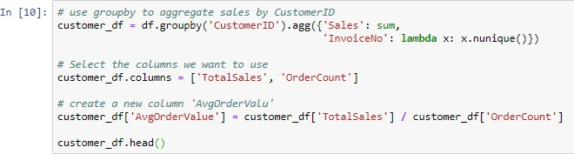
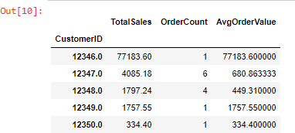
Implementation
Data Cleaning
Below, we will remove data that is not helpful, missing, or potentially cause issues in the long run.

Slide 11
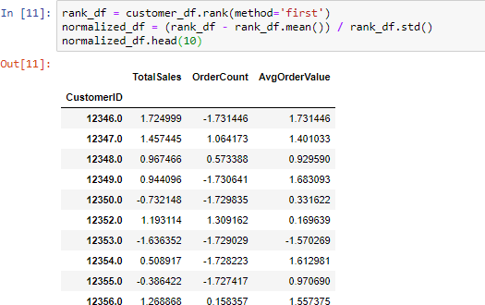
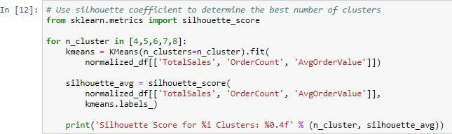
Implementation
Normalize the Data
Clustering algorithms like K-means are sensitive to the scales of the data used, so we’ll want to normalize the data
Silhouette (Clustering)
Silhouette means how to interpret and verify consistency within data structures. This method provides a picture showing how well each item is organized.

Slide 12
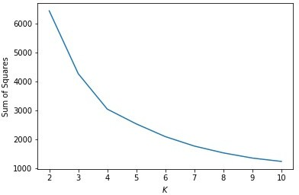
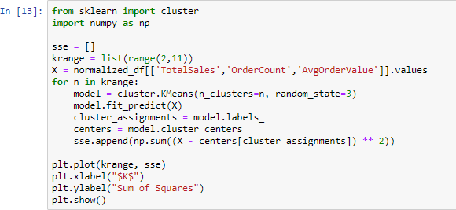
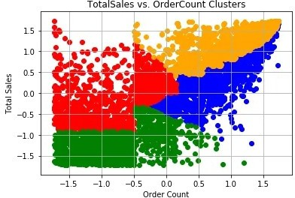
Implementation
Elbow Criterion Method(with the Sum of Squared Errors (SSE)):
The idea behind the elbow method is to run the k-mean correlation in the given data for k values (num_clusters, e.g. k = 1 to 10), and for each k value, to calculate the sum of squared errors (SSE).
Green customers have the lowest price and lowest order count, which means they are the lowest bidder. On the other hand, orange customers have the highest total SALE and highest order count, indicating that they are the highest.

Slide 13
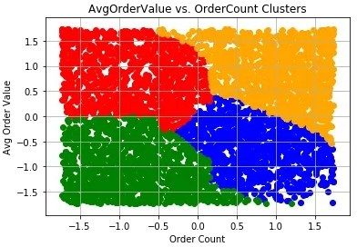
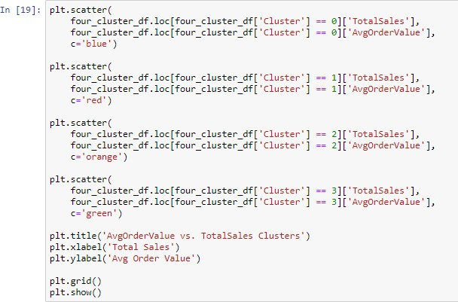
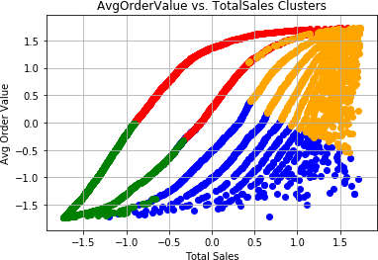
Implementation
In this structure, we consider the average order value vs the order value. Once again, green buyers are the lowest price and the customers in the orange are the highest prices.

Slide 14

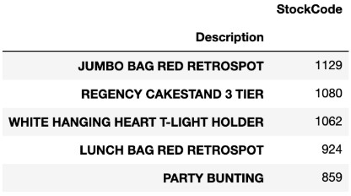
Implementation
The Best-selling item by segment
We know we have 4 categories and we know how much they spend on each purchase, their total usage, and the number of their orders. The next thing we can do is to help us better understand customer segments to find out which items are best sold in each segment.
Based on this information, we now know that the Jumbo Bag Red Retrospot is the best-selling item by our most expensive team. With that information available, we can make recommendations for other potential customers in this section.

Slide 15
Results
R
Here, the result states that the orange cluster as the highest value customers, green as the lowest value customers, and the blue and red as high opportunity customers.
Result also concludes that the Jumbo Bag ed Retrospot is the best-selling item.

Slide 16
Conclusion
As our dataset was unlabelled, in this paper we have opted for internal clustering validation rather than external clustering validation, which depends on some external data like labels. Internal cluster validation can be used for choosing clustering algorithm which best suits the dataset and can correctly cluster data into its opposite cluster.
Customer segmentation can have a positive impact on a business if done properly.
Hence we can give special discounts or gift vouchers to the people of orange clusters to retain them for long and for people in blue and red cluster we can give discounts and do advertisement of highly selling objects to attract them, and for the low value people which are in green clusters, we can arrange feedback column to know what we can change to attract them as well.
Based on the above information, we now know that the Jumbo Bag Red Retrospot is the best-selling item by our most expensive team. With that information available, we can make recommendations for other potential customers in this section.

Slide 17
References
Blanchard, Tommy. Bhatnagar, Pranshu. Behera, Trash. (2019). Marketing Analytics Scientific Data: Achieve your marketing objectives with Python's data analytics capabilities. S.l: Packt printing is limited
Griva, A., Bardaki, C., Pramatari, K., Papakiriakopoulos, D. (2018). Sales business analysis: Customer categories use market basket data. Systems Expert Systems, 100, 1-16.
Hill, K. (2012, February 16). How Target found out that a teenage girl was pregnant prior to her father's pregnancy. Forbes.com. Retrieved from
https://www.forbes.com/sites/kashmirhill/2012/02/16/how-target-figured- out-a-teen-girl- was pregnant- before her father-in-law
Sulekha Goyat. "The basis of market segmentation: a critical review of the literature. European Journal of Business and Management www.iiste.org. 2011. ISSN 2222-1905 (Paper) ISSN 2222-2839 (Online).
Vol 3, No.9, 2011
By Jerry W Thomas. 2007. Accessed at: www.decisionanalyst.com on July 12, 2015.
T.Nelson Gnanaraj, Dr.K.Ramesh Kumar N.Monica. AnuManufactured cluster analysis using a new algorithm from structured and unstructur
Vaishali R. Patel and Rupa G. Mehta “Impact of Outlier Removal and Normalization Approach in Modified k-Means Clustering Algorithm”, IJCSI,Year: 2011.

Slide 18
Thank you !

